Slide 1
Prestation of MAD
Name: MAMUN MD AL
StudentID:1838012008

Slide 2
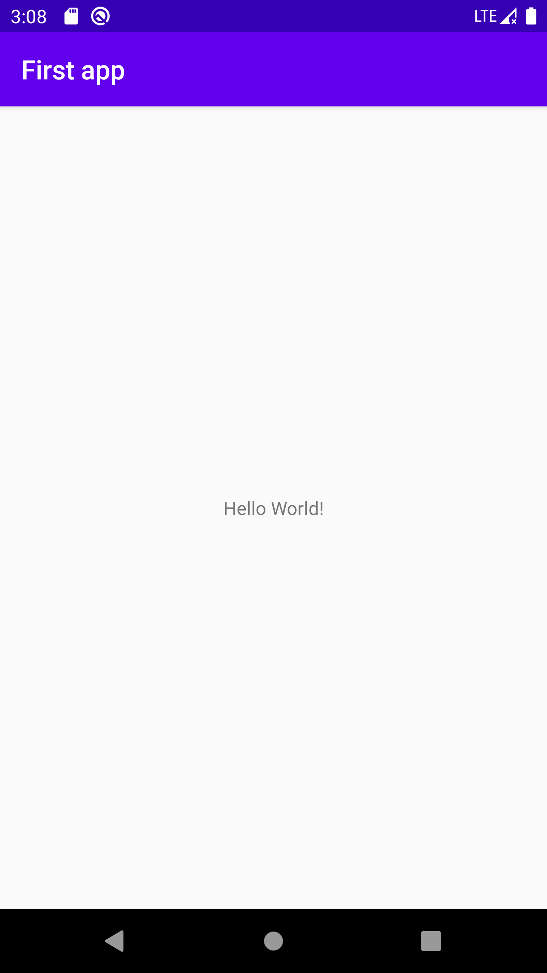
Hello world project
Key knowledge
How to install android studio
Create black activity
Create virtual device
Description: After knowing those key knowledge, just need to click option in android studio, after emulator run successfully. you can see your first project.

Slide 3

Chinese Cuisine
Key knowledge
Design layout
Design resources
Use of Spinner
Design code to handle button click
Description: This is an app which is about Chinese cuisine. Where u can know about Chinese cuisine. Use above this knowledge we can make app like this video .

Slide 4
Roshambo
Key Knowledge
Define resources
Handle button event
Random number
Image view
Description: Two images represent two persons A and B. Their initial choices are selected randomly.
When button clicked, each person select one choice from rock, paper, and scissors randomly.
According to their choices and the rules, determine who win the game.

Slide 5
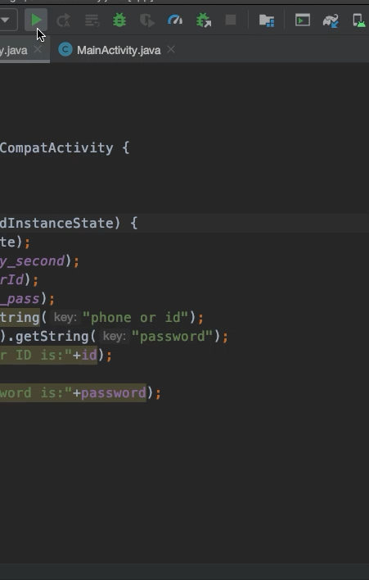
QQ-login
Key knowledge
Splash screen
Intent
Pass value one activity to another activity
Description: An Intent is a type of message that Android components use to communicate with one another.
Create an explicit Intent
Start an activity
Pass information to another activity
Retrieve information from an intent
Create an implicit intent that specifies an action
Intent resolution for implicit intent
Retrieve the value of a string resource in code

Slide 6
WHO
Key knowledge
Activity lifecycle, main states of activity
Activity lifecycle methods
Handler
Save and retrieve instance state
Activity stack
Description: Create a new project the layout include 1 textview, and 3 button: start, stop, reset. When button is clicked , display a message in textview. Implement a method runTime which will using handler to count and display the count.declare a class varable seconds,implement method runTime() implement the business rule. Device Configuration.

Slide 7
Top list
Key knowledge
How to Organize data
ListView
Define a ListView in XML file
Pulls data from an array
Handle item click event
Tell which item is clicked
Pulls data from a database
List Activity
Description: Design and implement top level activity and then Design and implement category activity and Design and implement detail activity. Those are the main part of this projects and here we also used ArrayAdapter to Pulls data from an Object array. We used our above knowledge to make an app like this video.

Slide 8
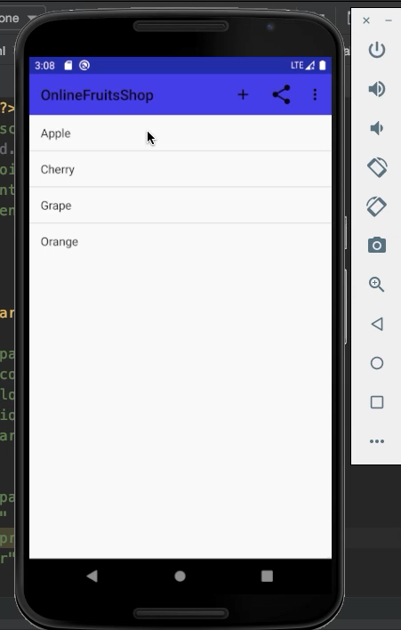
Fruits
Key Knowledge
Add a basic app bar.
Replace the basic app bar with a toolbar.
Add a Create Order action.
Implement the Up button.
Add a share action provider
Description: Actually in here we have use so many things, basic app bar, Action Bar, Theme, Support Libraries and compared to Activity, AppCompatActivity contains extra smarts that allow it to work with the themes from the AppCompat Support Library and How to apply a theme. With those knowledge combination we made this app. This video will help you to understand about all the method.

Slide 9
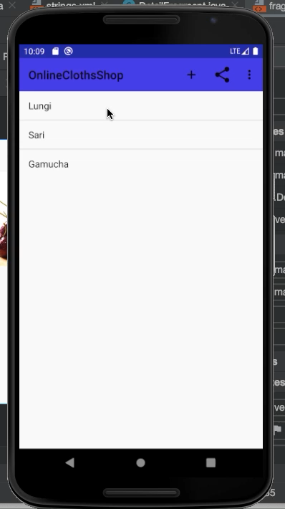
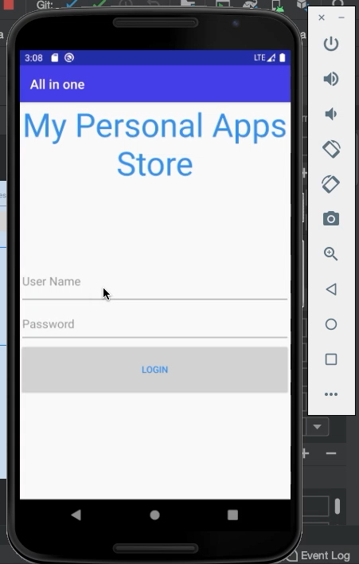
Clothes & personal app store
Key Knowledge
Actually base on our class Knowledge laoshi asked us to do our own projects. And implement our own idea and make some new projects .So I did so many but I can’t share all of them in here. Just some here and I have some personal projects as well. But I will show my all project personally.

Slide 10
Thank you for your hardworking Sue laoshi
I Appreciate your hard work and so grateful for your excellent teaching.
Wish you best

